Slide 1
Drone delivery system unit
Day 1
Standards:
8.PS2.3
8PS2.4
8.PS2.5

Slide 2
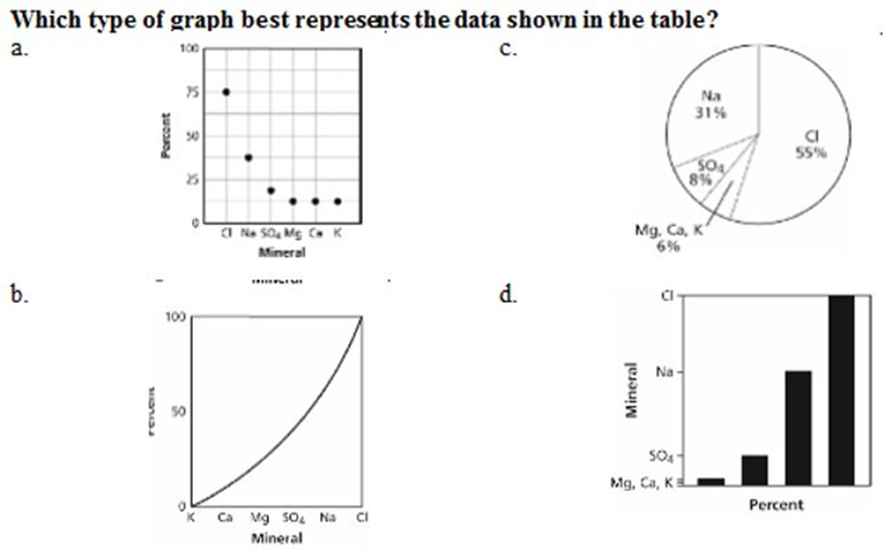
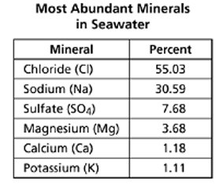


Slide 3
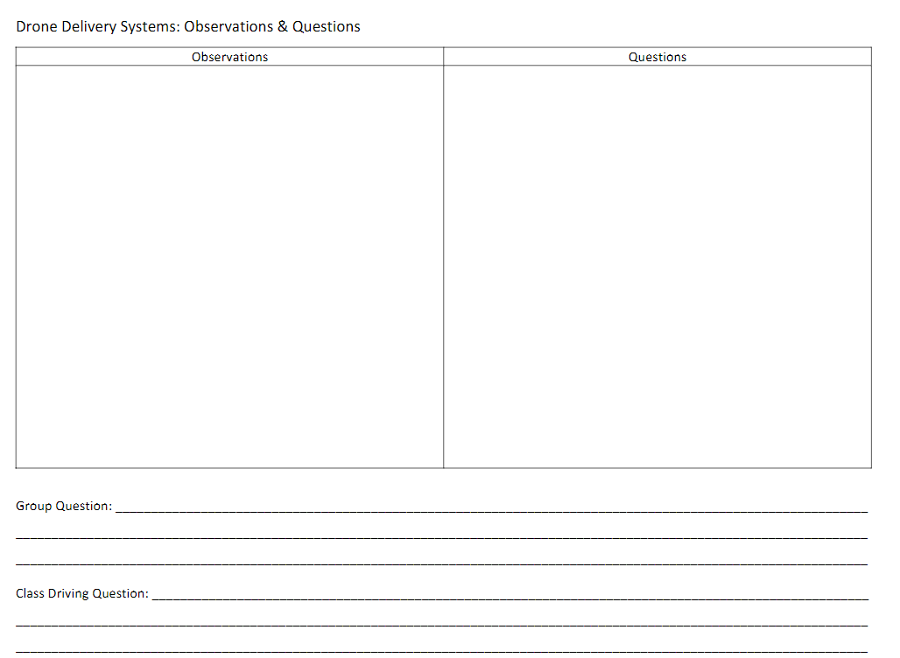
Draw this on a piece of notebook paper.
Write down observations and questions as we watch and read about the drone delivery system
Standards: 8.PS2.3, 8PS2.4, 8.PS2.5

Slide 4
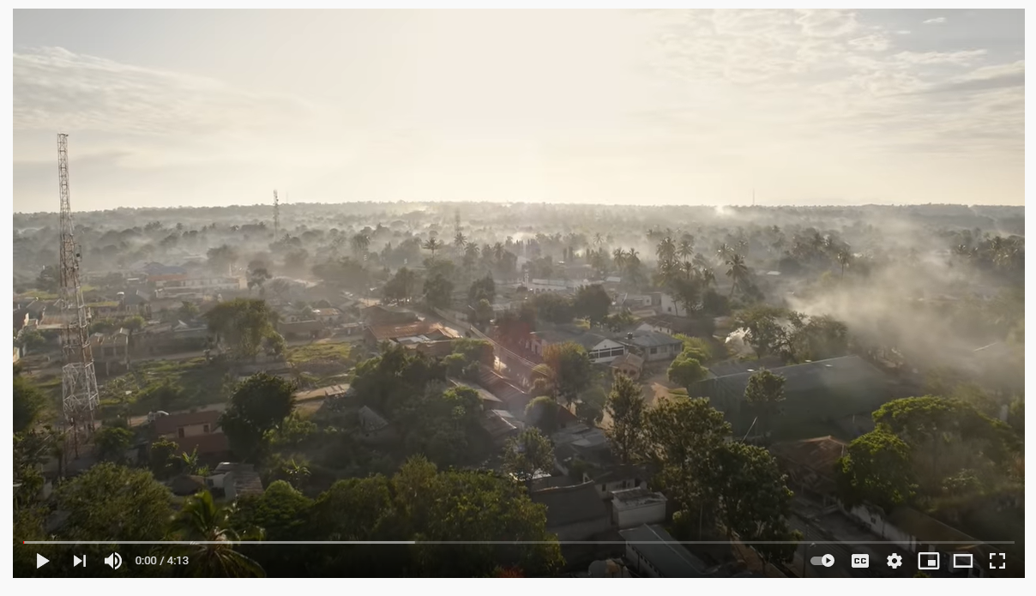
Deliver Future: Parcelcopter 4.0: Delivering vital medicines by drone
Standards: 8.PS2.3, 8PS2.4, 8.PS2.5

Slide 5
DRONE DELIVERY SYSTEMS In areas with geographical challenges, like Ukerewe Island on the east side of Lake Victoria in Africa, people need medicine—if they do not get it, they do not survive. More than 400,000 people live in Ukerewe District, and they face numerous diseases such as malaria, typhoid and schistosomiasis. Since the district is located on an island with a lack of road infrastructure, medicine is not able to be delivered the same day. The roads are very poor, especially in rural areas. Medicine can be delivered by lake, but the vessels are unreliable. To improve the delivery of health supplies in these hard-to-reach island areas, DHL, GIZ, and Wingcopter designed and built the Parcelcopter. But what about during the monsoon seasons in Africa? To keep drones from getting swept away in the flood waters, drones can air drop the packages; however, medical supplies will be damaged when landing.
Standards: 8.PS2.3, 8PS2.4, 8.PS2.5

Slide 6
Monsoon Rain East Africa
Standards: 8.PS2.3, 8PS2.4, 8.PS2.5

Slide 7
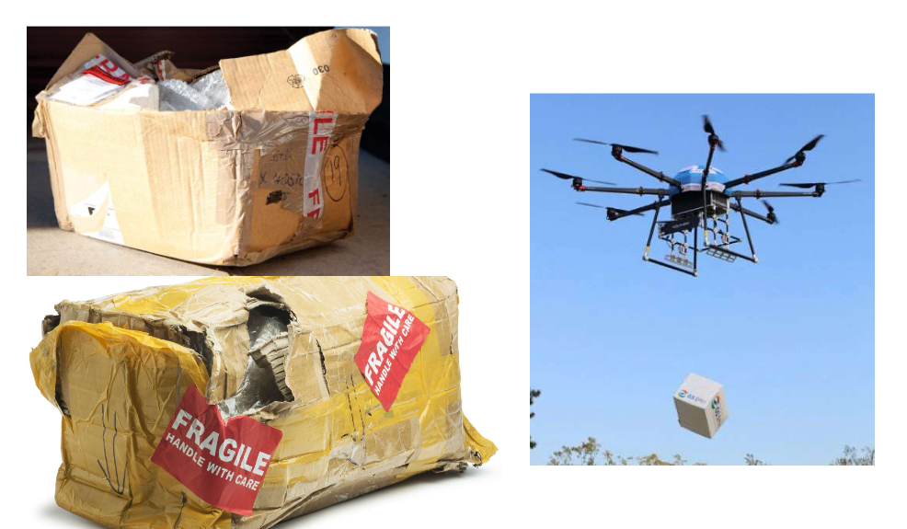
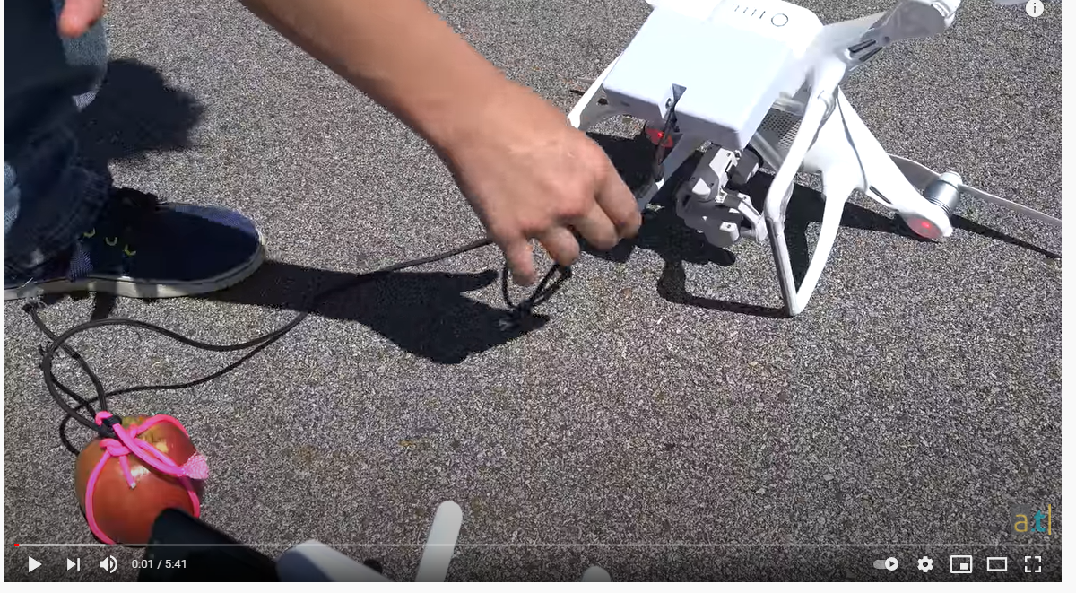
Drone airdrop pictures and video
Write down your observations and questions.
Standards: 8.PS2.3, 8PS2.4, 8.PS2.5

Slide 8
Driving question: focus on medical supplies being damaged in air drops during the monsoon seasons (6months)
Share your questions with your lab group and develop one question for your entire group. Write the question on your paper under group question.
The class will read all the group questions and develop a driving question to work towards answering to make sense of the phenomenon.
Everyone will write the driving question at the bottom of their observation and question sheet.
Standards: 8.PS2.3, 8PS2.4, 8.PS2.5

Slide 9
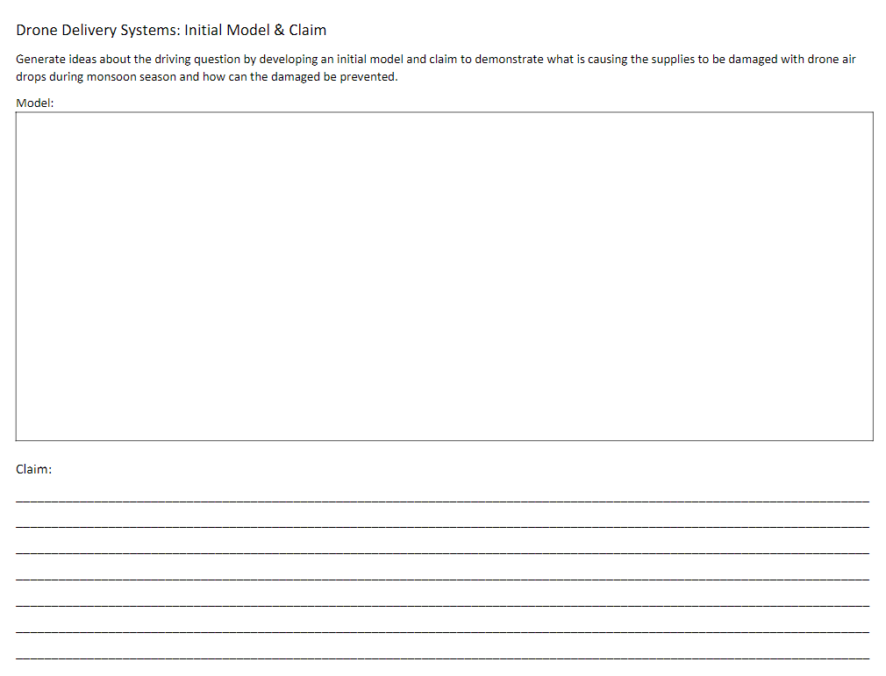
Initial phenomenon model & claim
Draw this on a sheet of paper
Develop an initial model to demonstrate what is causing the supplies to be damaged.
Discuss initial claims/explanations.
Standards: 8.PS2.3, 8PS2.4, 8.PS2.5

Slide 10

Standards: 8.PS2.3, 8PS2.4, 8.PS2.5

Slide 11
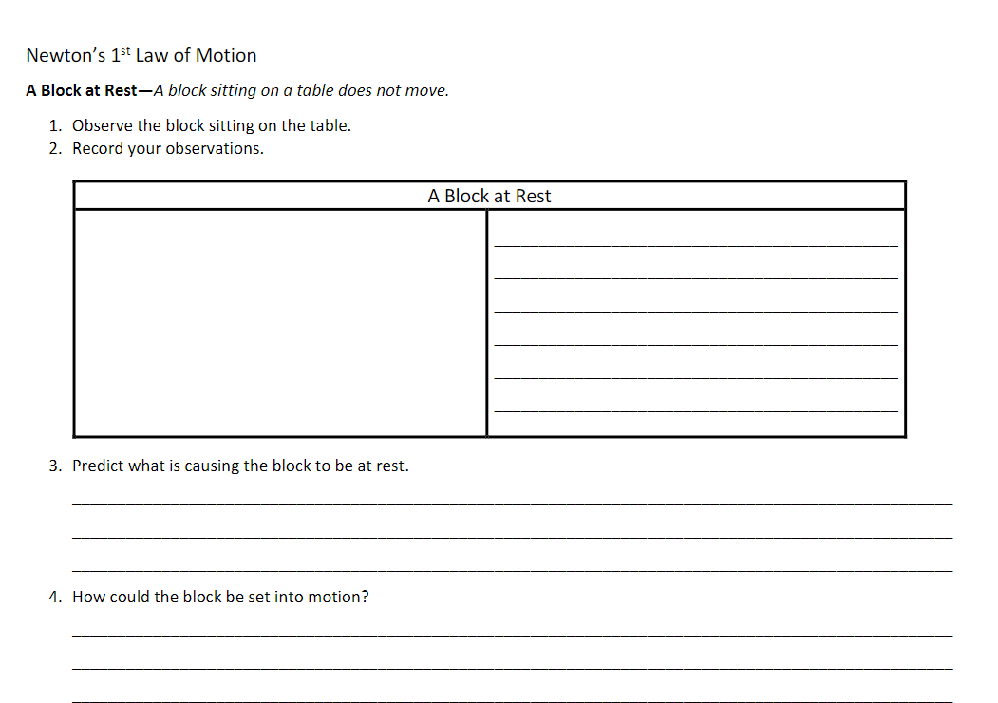
Standards: 8.PS2.3, 8PS2.4, 8.PS2.5

Slide 12
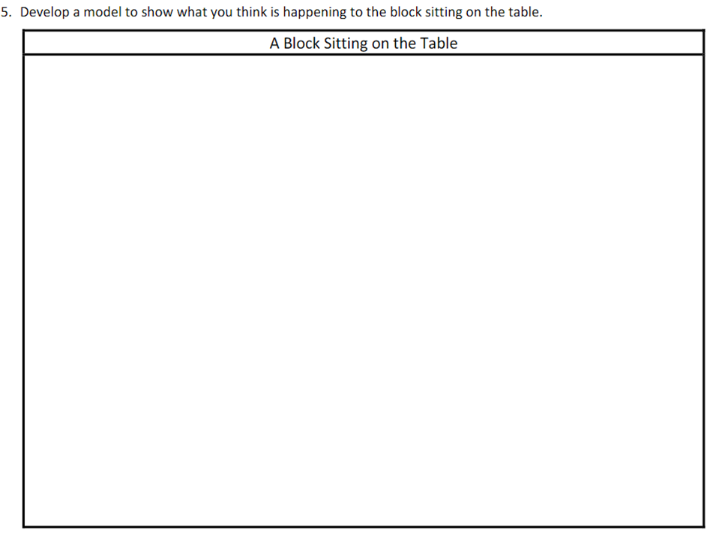
Draw this on the back of your paper.
Standards: 8.PS2.3, 8PS2.4, 8.PS2.5

Slide 13
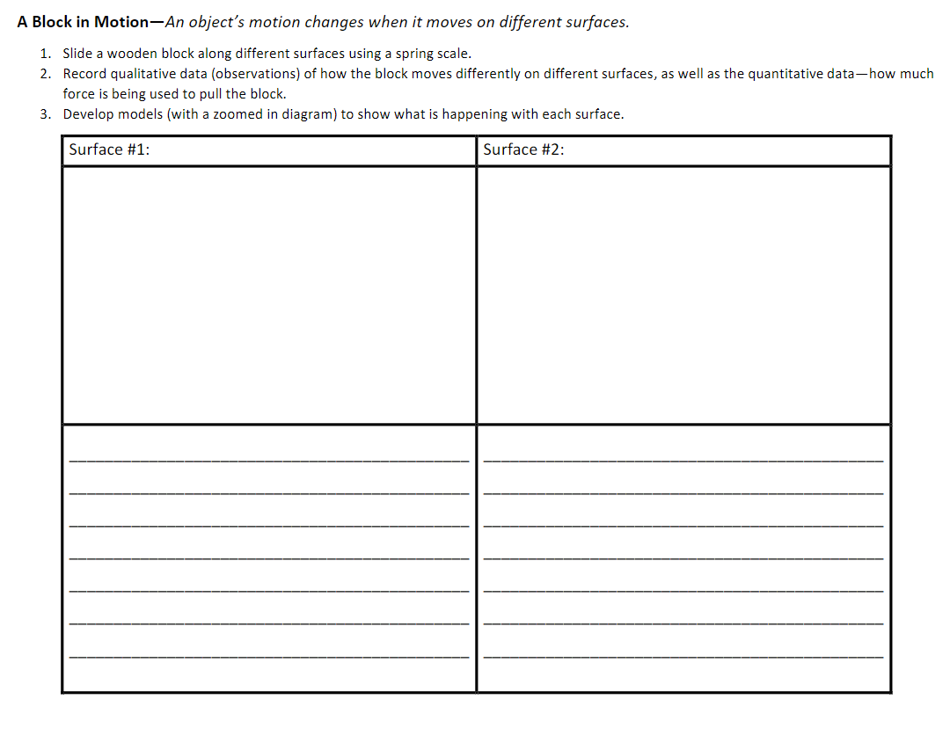
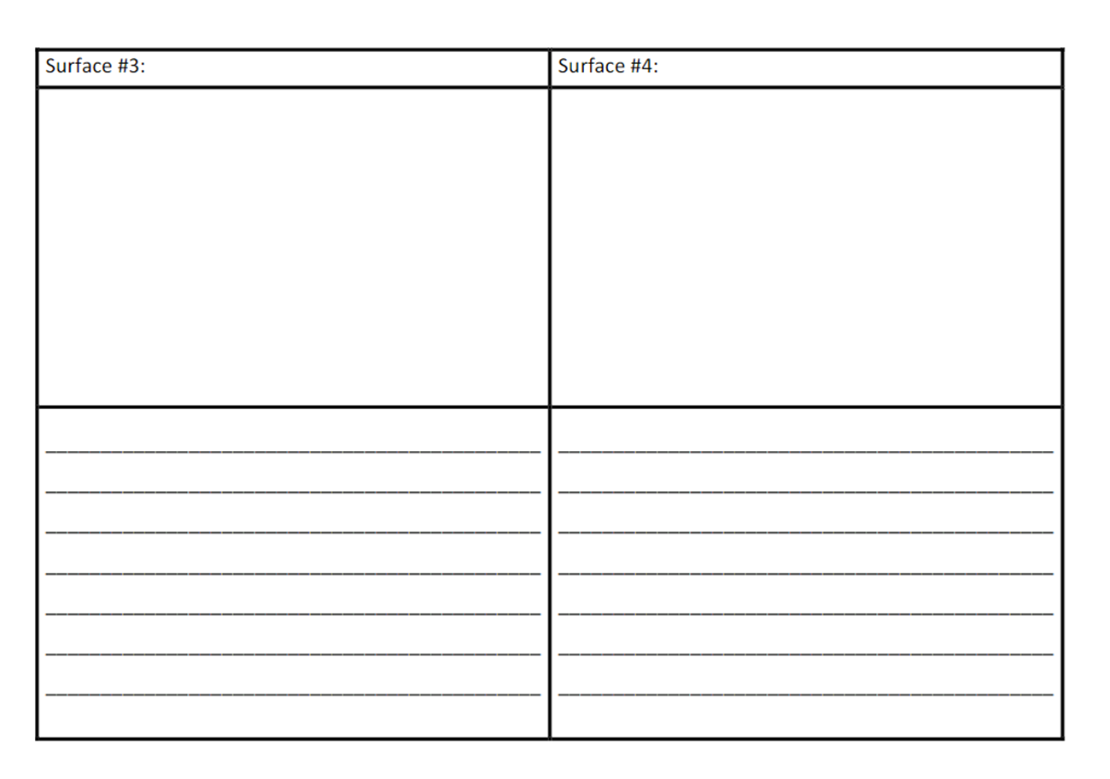
Standards: 8.PS2.3, 8PS2.4, 8.PS2.5

Slide 14
Exit Ticket:
What is the Driving Questions your class chose?

